Slide 1

Object Oriented Design & Programming (21CSC101T)
Arvind Kharwal

Slide 2
Component Diagram

Slide 3
The purpose of a component diagram is to show the relationship between different components in a system.
For the purpose of UML 2.0, the term "component" refers to a module of classes that represent independent systems or subsystems with the ability to interface with the rest of the system.
There exists a whole development approach that revolves around components: component-based development (CBD).

Slide 4
In this approach, component diagrams allow the planner to identify the different components so the whole system does what it's supposed to do.
More commonly, in an OO programming approach, the component diagram allows a senior developer to group classes together based on a common purpose so that the developer and others can look at a software development project at a high level.

Slide 5
Benefits of component diagram

Slide 6
Though component diagrams may seem complex at first glance, they are invaluable when it comes to building your system. Component diagrams can help your team:
Imagine the system’s physical structure.
Pay attention to the system’s components and how they relate.
Emphasize the service behavior as it relates to the interface.

Slide 7
How to use component diagrams?

Slide 8
A component diagram in UML gives a bird’s-eye view of your software system.
Understanding the exact service behavior that each piece of your software provides will make you a better developer.
Component diagrams can describe software systems that are implemented in any programming language or style.

Slide 9
In component diagrams, the Unified Modeling Language dictates that components and packages are wired together with lines representing assembly connectors and delegation connectors.

Slide 10
Component Diagram Shapes and Symbols

Slide 11
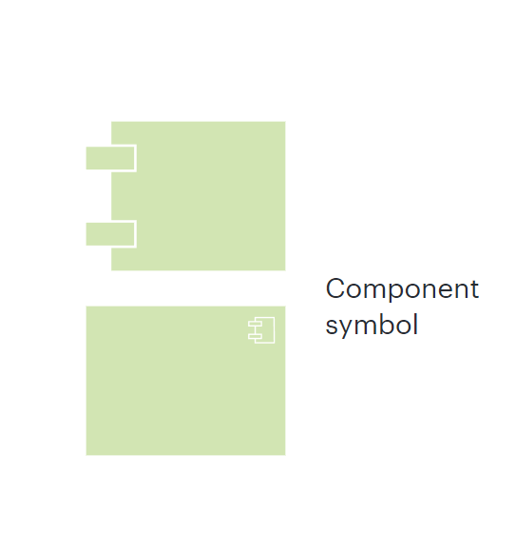
Component:
An entity is required to execute a stereotype function. A component provides and consumes behavior through interfaces, as well as through other components.

Slide 12
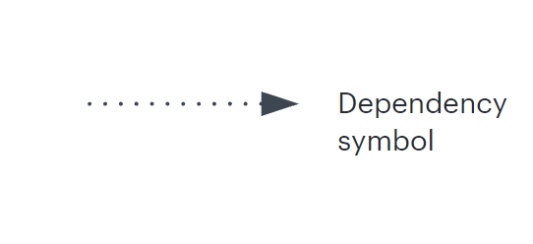
Dependency:
It shows that one part of your system depends on another. Dependencies are represented by dashed lines linking one component (or element) to another.

Slide 13
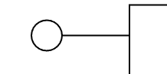
Provided interfaces
A straight line from the component box with an attached circle. These symbols represent the interfaces where a component produces information used by the required interface of another component.

Slide 14
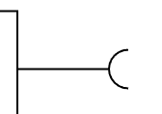
Required interfaces:
A straight line from the component box with an attached half circle (also represented as a dashed arrow with an open arrow). These symbols represent the interfaces where a component requires information in order to perform its proper function.

Slide 15
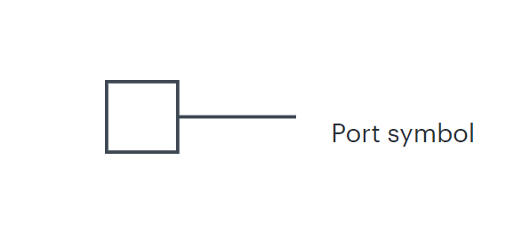
Port
It specifies a separate interaction point between the component and the environment. Ports are symbolized with a small square.

Slide 16
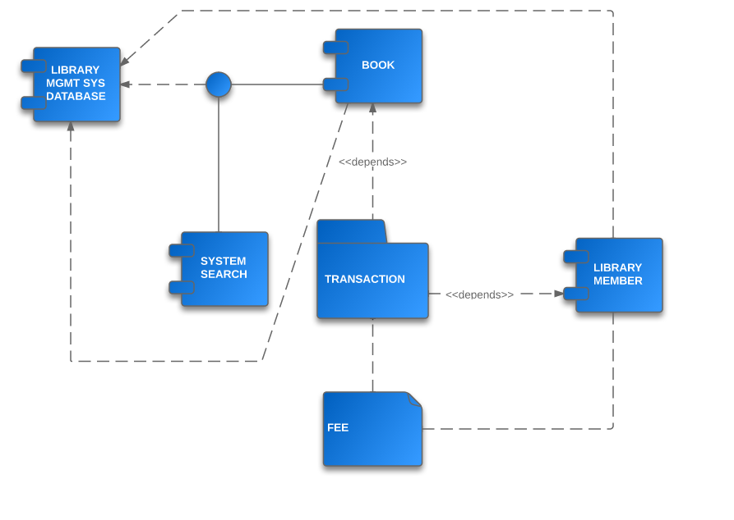
Example

Slide 17
Thank You

